Slide 1


The Indiana Spatial Data Portal: A look under the hood
Justin P. Peters
Research Analytics
Indiana University
5-13-15
Prepared for the Indiana Geographic Information Council (IGIC) 2015 State conference in Bloomington, IN
Notes:
Intro Slide

Slide 2
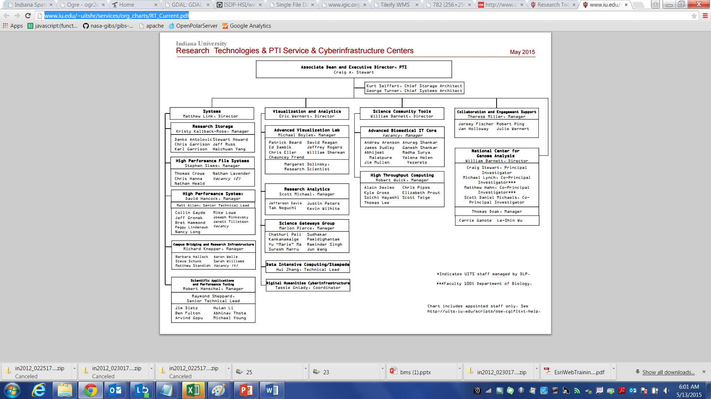
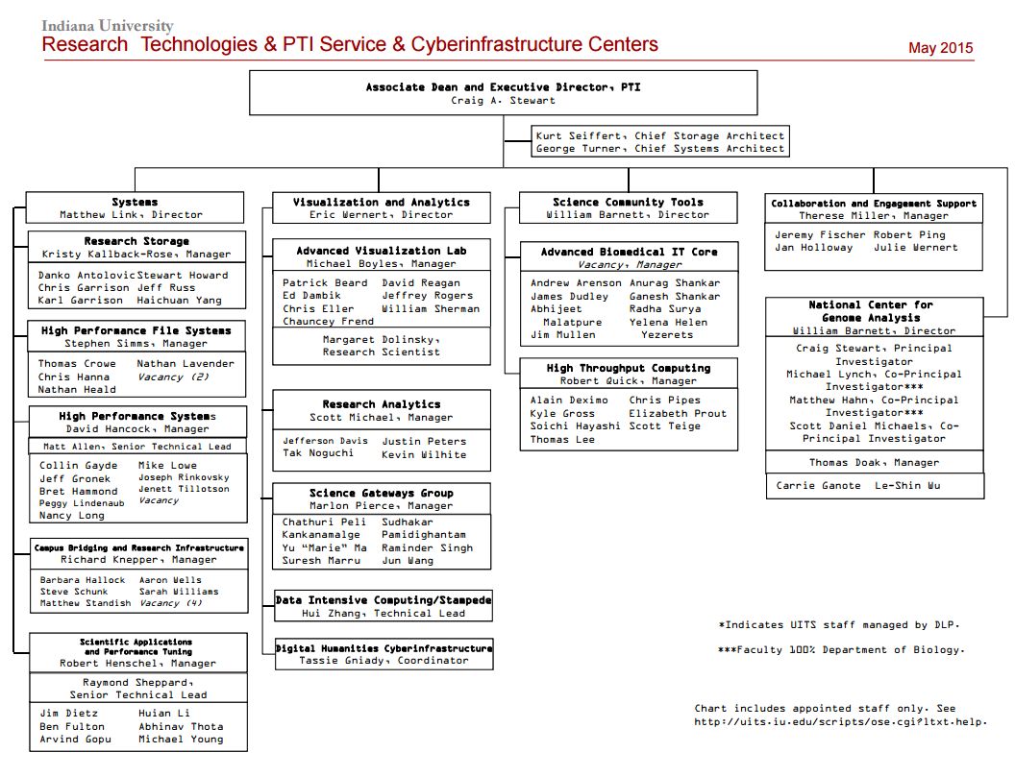

Slide 3
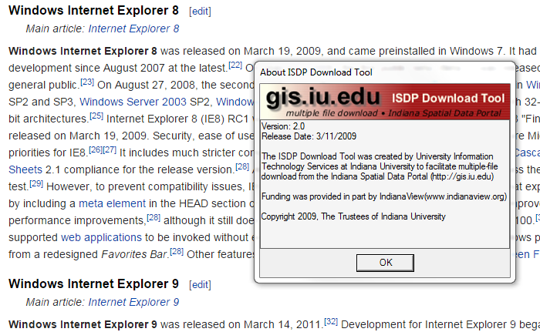
Why is an update needed?

Slide 4
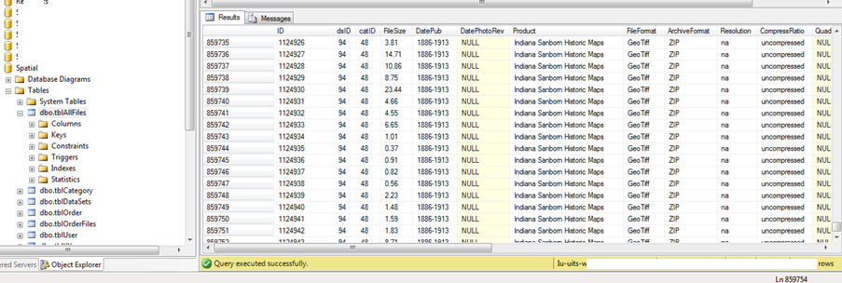
MS SQL Server database with records for files, users, orders, etc.
Over 1 million files stored on the Scholarly Data Archive indexed in DB

Slide 5
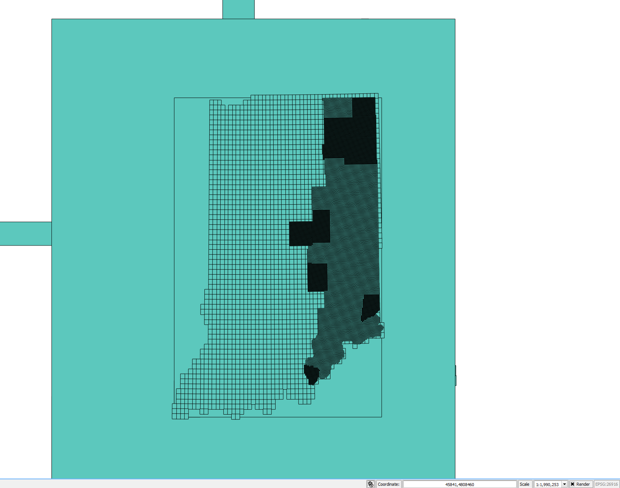
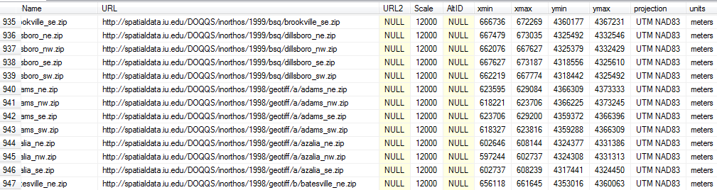
4 fields enable bounding box
Fields for geospatial projection and units enable geospatial integration and graphic representation

Slide 6

IU SDA (Scholarly Data Archive) https://kb.iu.edu/d/aiyi
Room for petabytes of data. Currently using over 30 terabytes.

Slide 7
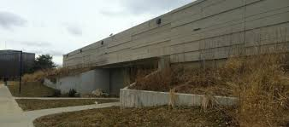
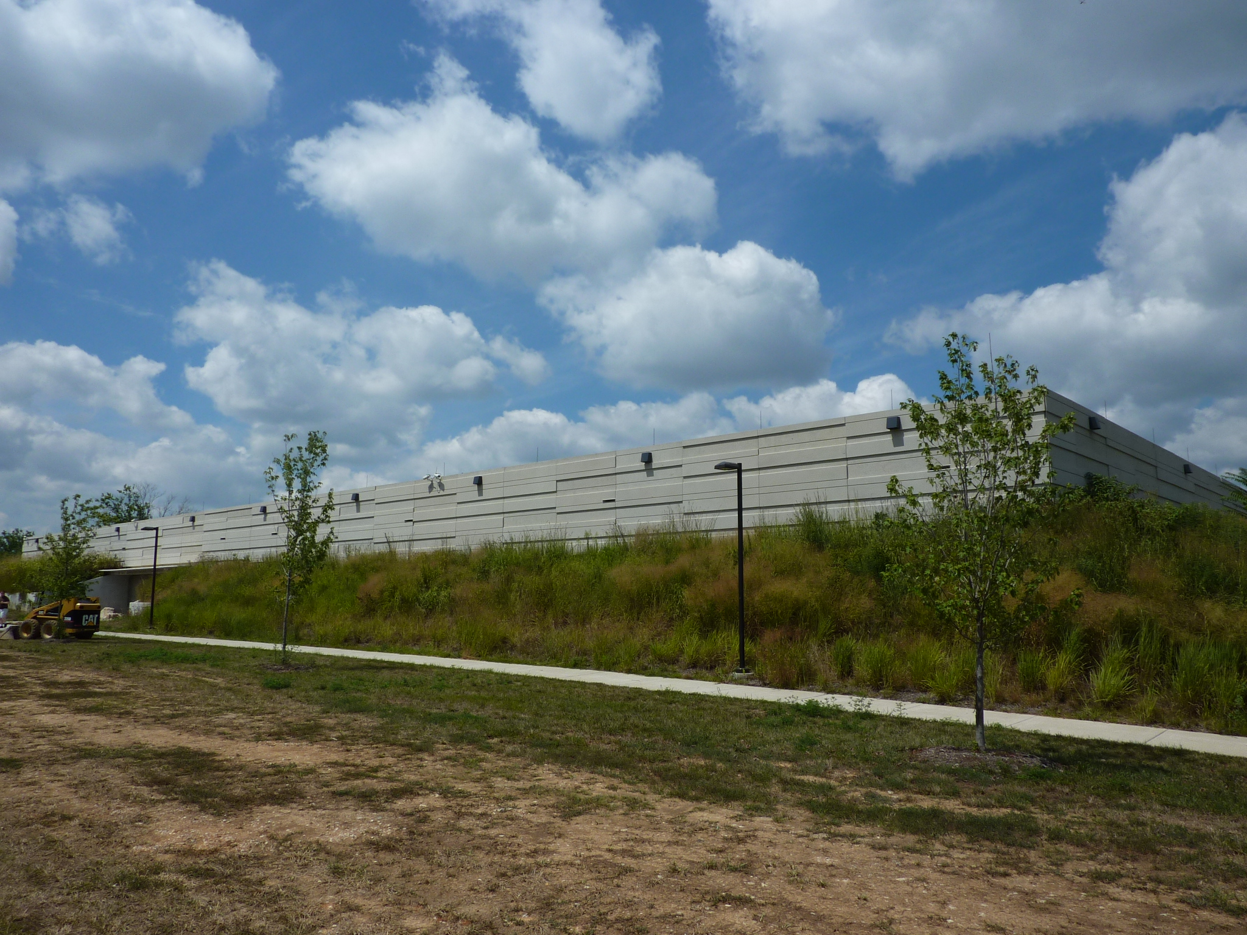
IU Data Center https://dcops.iu.edu/

Slide 8
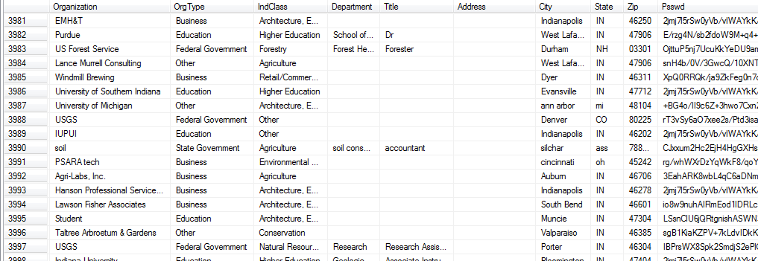
Users
Over 4000 active users from all sectors

Slide 9
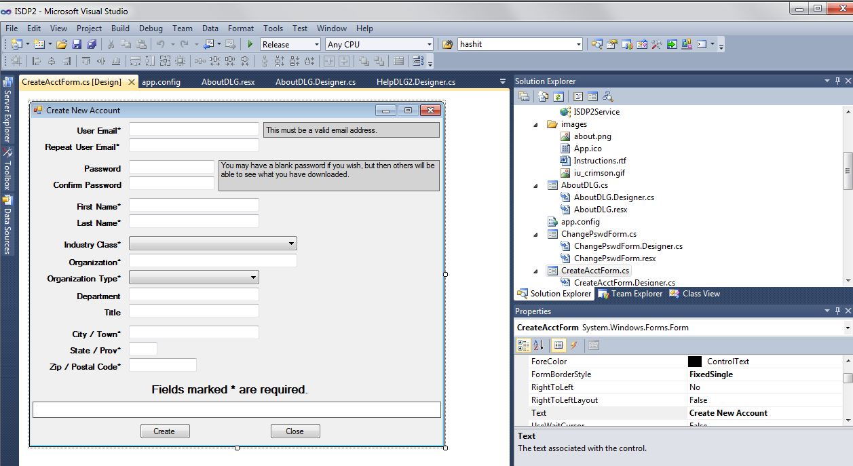
Current application created in Visual Studio with CS

Slide 10
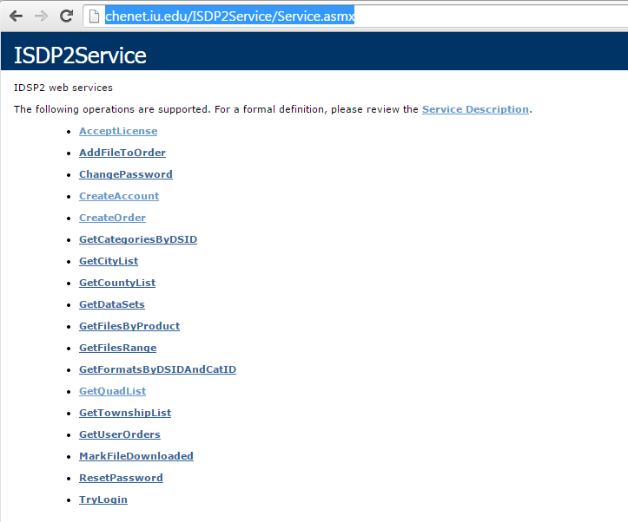
Current Shortcomings
Any changes require a new client download and installation for all users
Requires WSDL service and server
No staging of files (longer client sessions needed for many files)

Slide 11

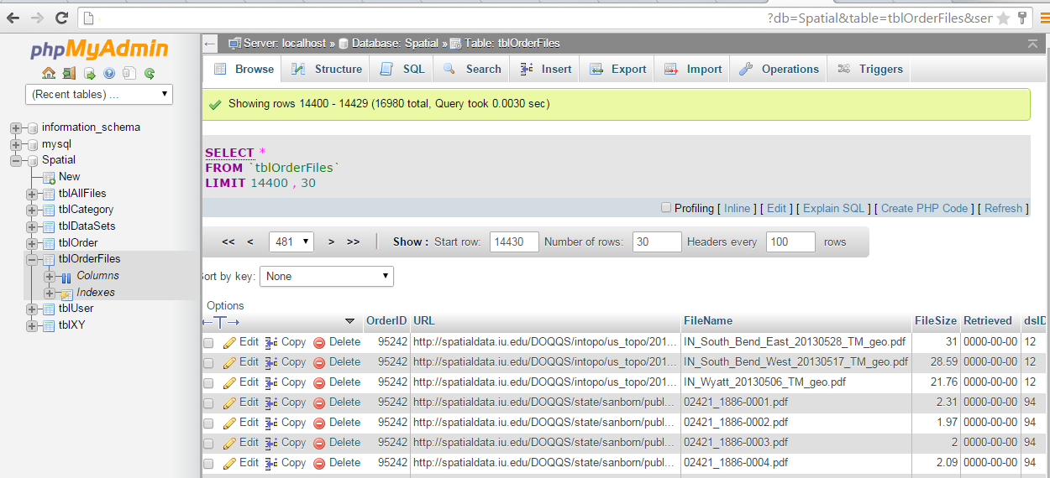
New web based application
Migration to open source
Mysql (database)

Slide 12

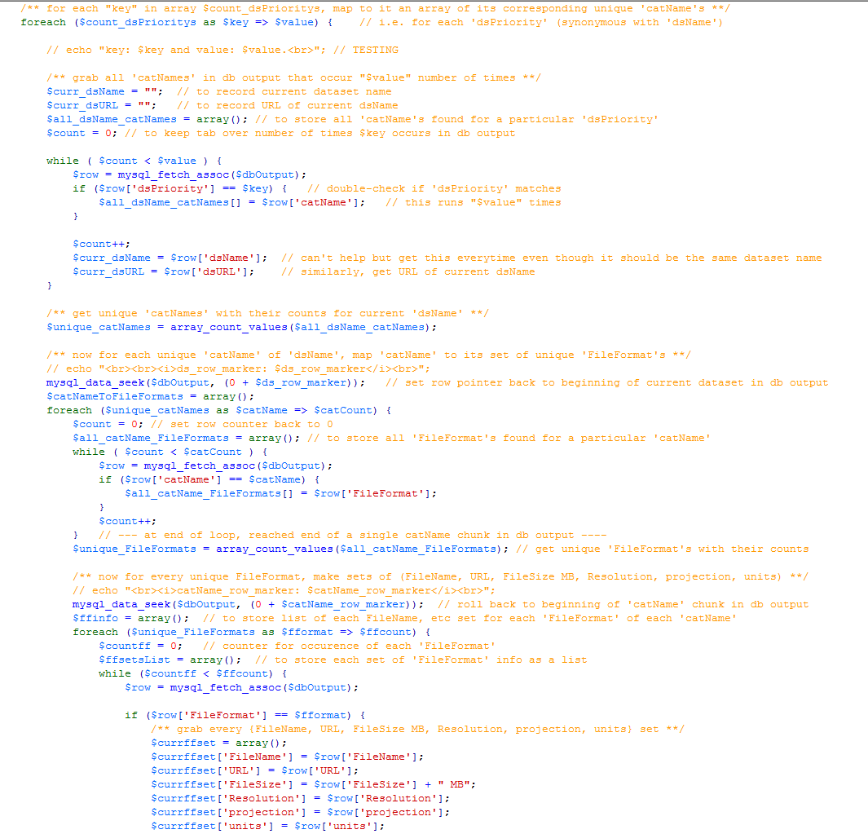
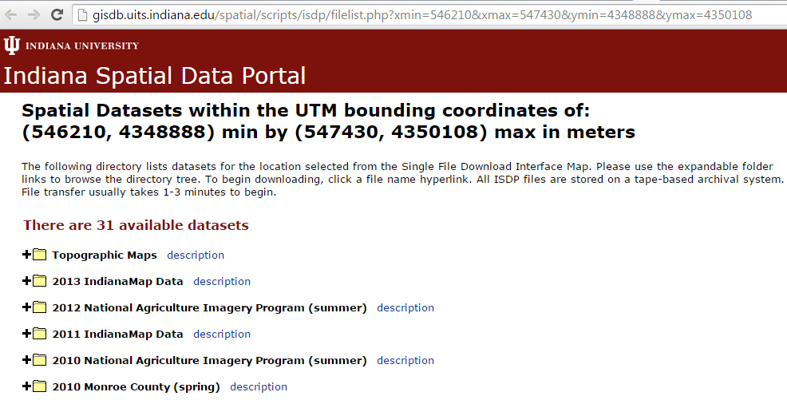
PHP (server side code)

Slide 13
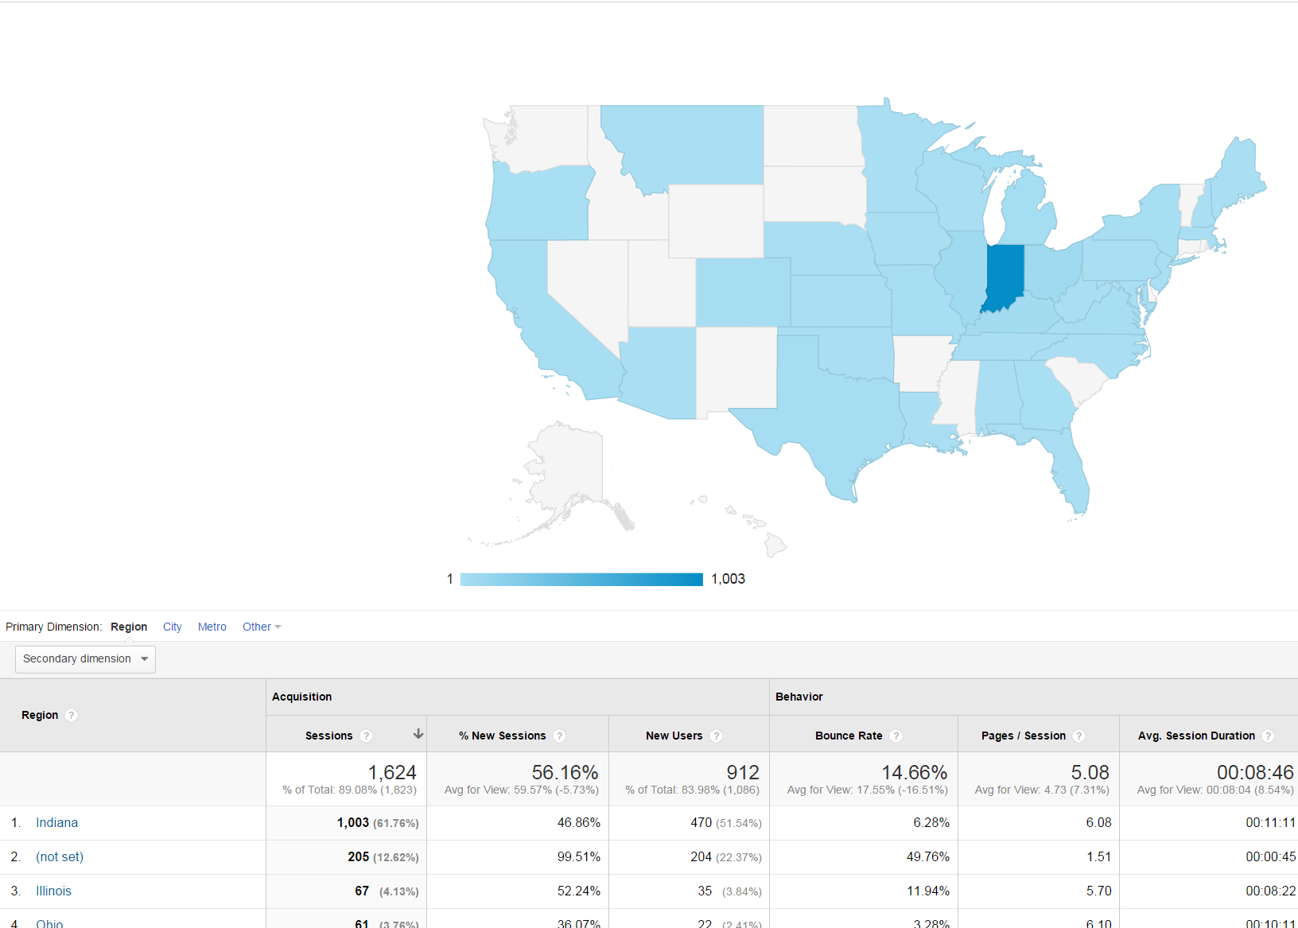
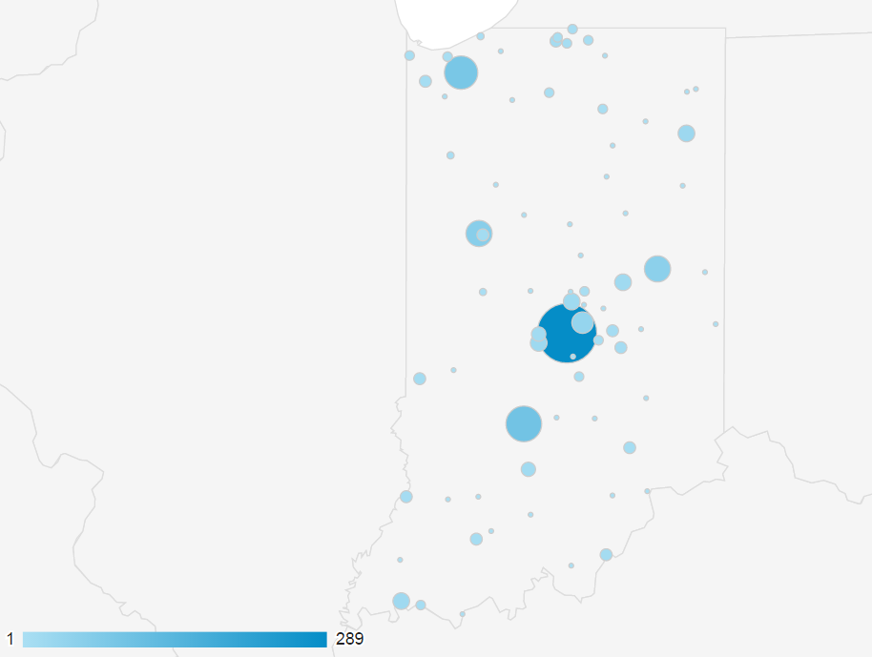
Single file download already integrated with Google analytics

Slide 14
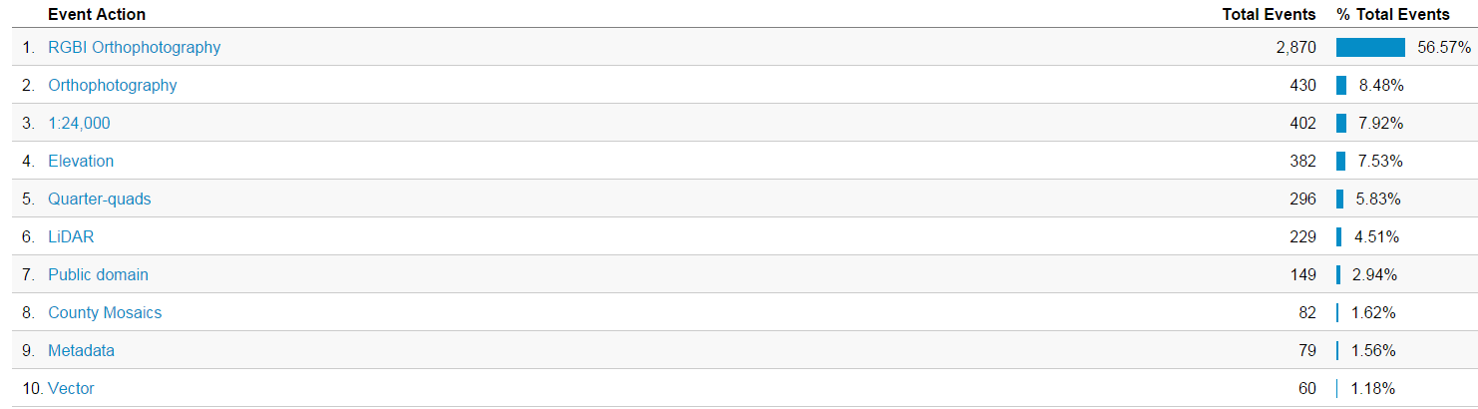
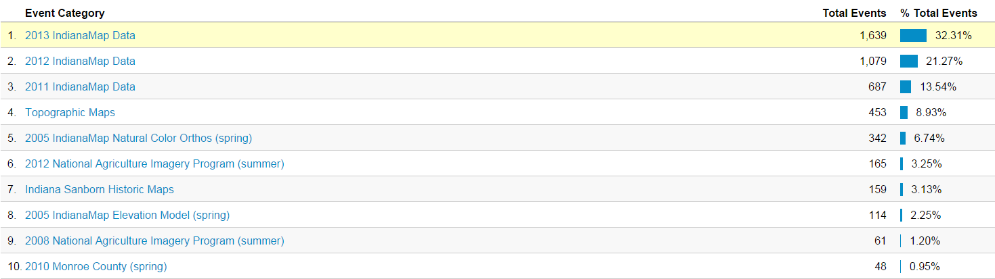
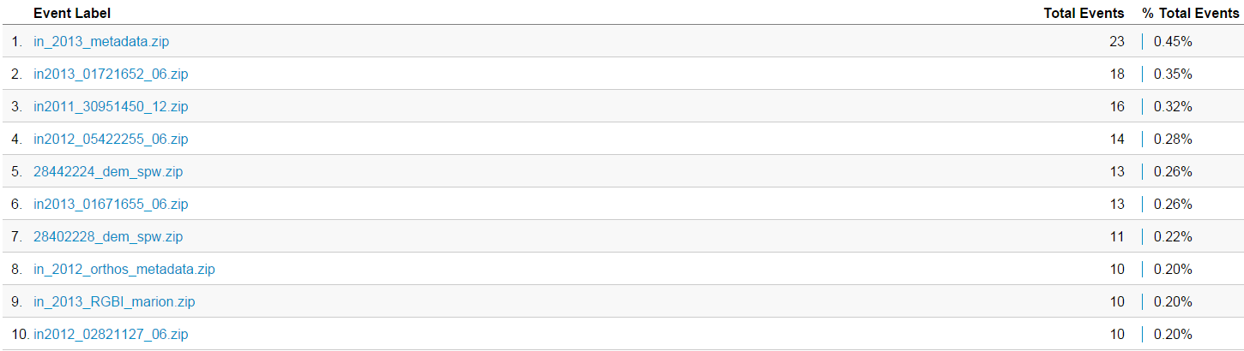

Slide 15
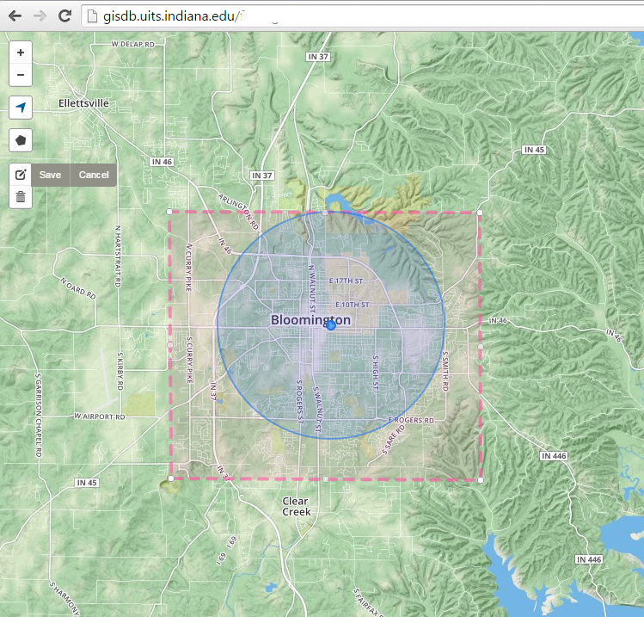
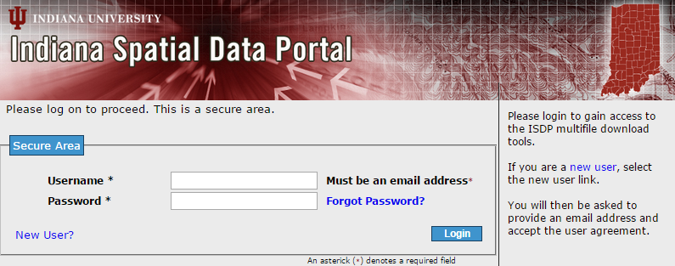
Multifile download tool redesign status:

Slide 16
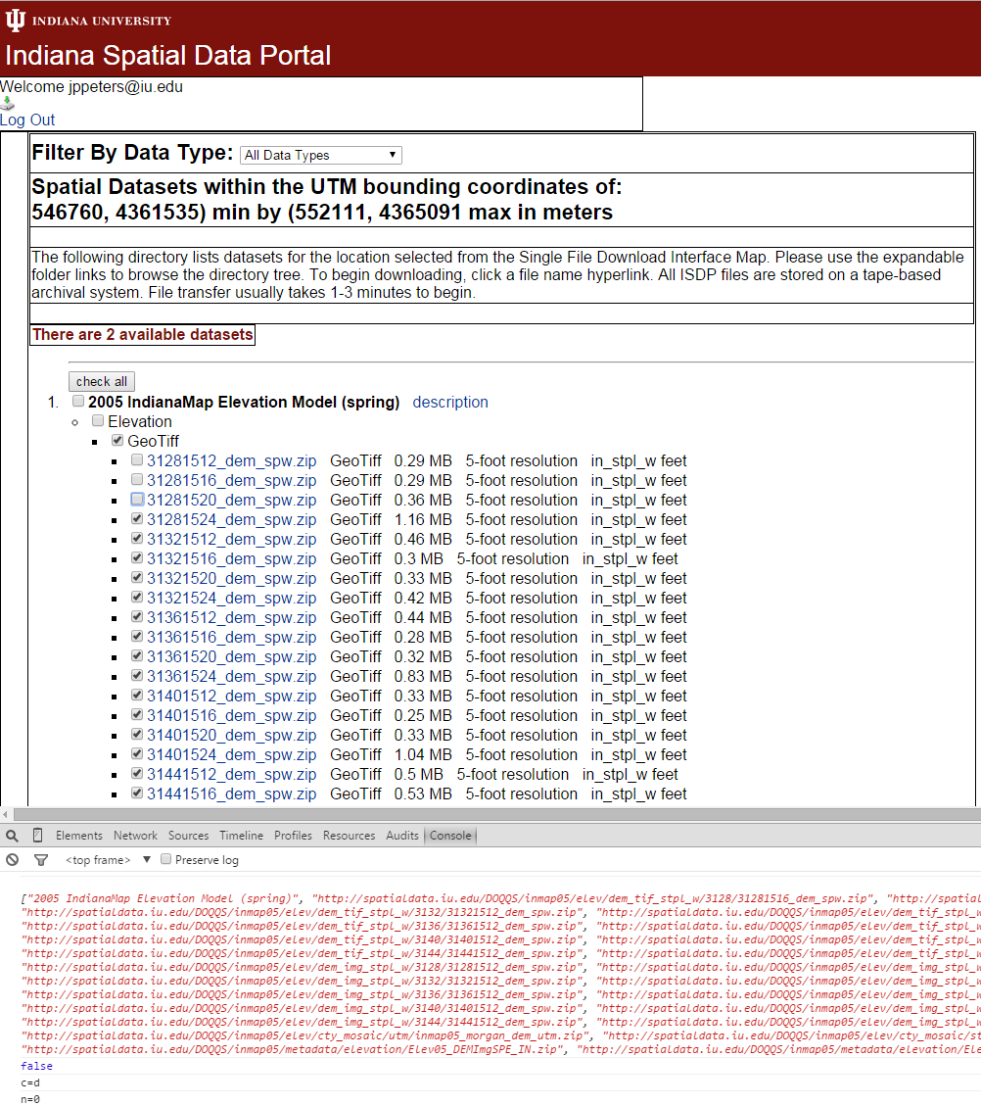
Multifile download tool redesign status:
User/session info
Drop down for data types
Bounding box
Select files
Shopping cart/Basket items

Slide 17
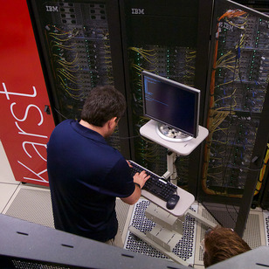
Enter the supercomputer Karst: https://kb.iu.edu/d/bezu
ISDP Karst Compute node details
CPUs | 2 Intel Xeon E5-2650 v2 8-core processors
Processor cores | 16
RAM | 32 GB
ISDP has one dedicated node: 20 TB RAID attached (user
files and download notification) Running RHEL6
Stage requested files from SDA
Pack zip/tar
Notify user via email when staging complete
Scheduled purge after x amount of time
DB does enable user flag download complete

Slide 18
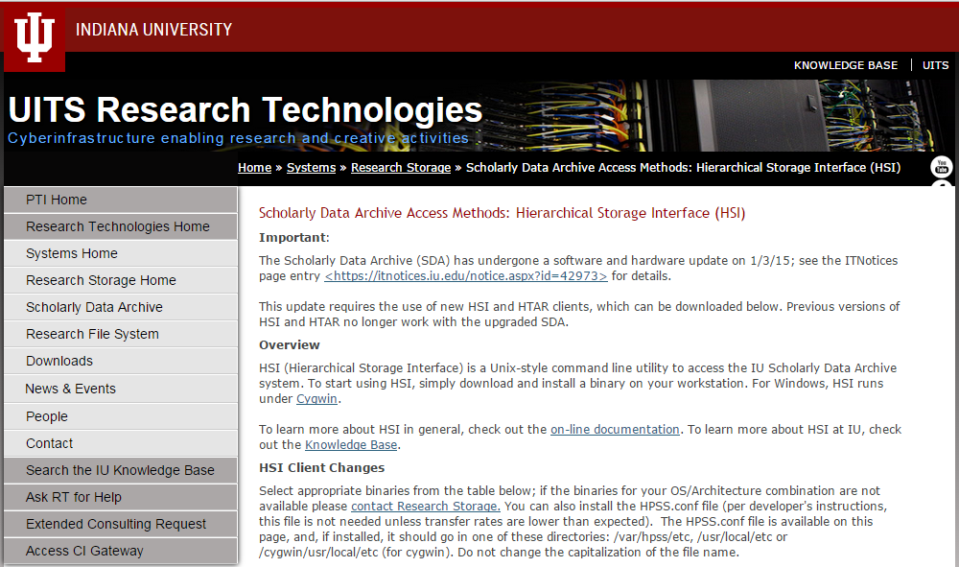
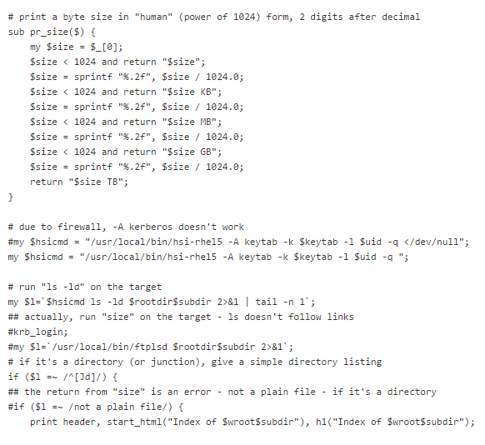
Scholarly Data Archive Access Method: Hierarchical Storage Interface (HSI)
http://rt.uits.iu.edu/systems/storage/hsi.php

Slide 19

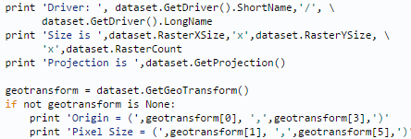
Other potential benefits of Karst Node:
GDAL/OGR, proj.4, QGIS, Grass, MapServer, otherpackages
Stage requested files from SDA,
Unpack zip/tar
Read/redefine projection proj4
Read/redefine Vector file format with OGR
Read/redefine Raster data format with GDAL
Merge files
Create tiles
Pack zip/tar
Update DB and notify user via email with hyperlink
Potential workflow with

